Slide 1
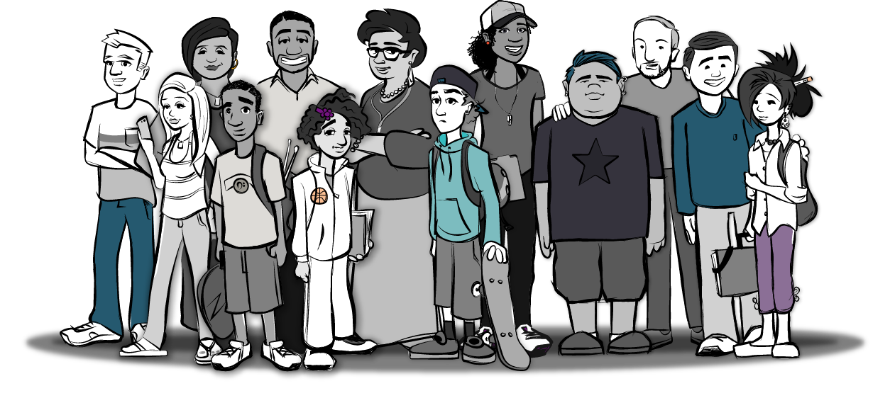
Healthy Relationships Toolkit for Parents
7th Grade

Slide 2
Session 1:
Parenting Positively

Slide 3
Goals of the Healthy Relationships Toolkit for Parents
Learn how to become better communicators with our children
Build our knowledge and skills so we can communicate our values about relationships to our children
Learn how to prepare our children to build healthy relationships before they start dating

Slide 4
Goals of the Healthy Relationships Toolkit for Parents
Learn the skills needed to assist our children with problems that may happen in their relationships with others
Learn information we can share with our family and friends
Have fun and enjoy our time together!

Slide 5
Overview of Sessions
Session 1: Parenting Positively (group session)
  Changes and pressures children face as they get older
  Positive parenting skills
  Parent-child communication skills
Session 2: Let’s Talk, Part 1 (in-home session)
  Provides a structured opportunity for parents to practice their communication skills with their children
  Allow parents an opportunity to practice skills learned in group sessions
Notes:
Introduction of Session Structure
Three of the sessions will be group sessions and three sessions will be done at home.
Each of the group and home sessions alternate weeks so this means that next week will be a home session and in two weeks, we’ll have another group session.
This will be followed by another home session and so on until all 6 sessions are completed.
Overview of Sessions
Session 1: Parenting Positively (group session)
Changes and pressures children face as they go through adolescence
Positive parenting skills
Parent-child communication
Session 2: Let’s Talk Part 1 (in-home session)
Provides a structured opportunity for parents to practice their communication skills with their children.
Allow parents an opportunity to practice skills learned in the group sessions

Slide 6
Overview of Sessions
Session 3: Parenting by Example (group session)
  Healthy vs. unhealthy relationship behaviors
  Teen dating violence
  Parents as relationship models
Session 4: Let’s Talk, Part 2 (in-home session)
  Provides parents with opportunities to practice their communication skills
Notes:
Overview of Sessions (continued)
Session 3: Parenting by Example (group session)
Healthy versus unhealthy relationship behaviors overview
Teen dating violence overview
Parents as relationship models
Session 4: Let’s Talk Part 2 (in-home session)
Provides parents with further opportunities to practice their communication skills

Slide 7
Overview of Sessions
Session 5: Parenting Skillfully (group session)
  Parental supervision
  Risky behaviors during the teen years
  Conflict resolution
Session 6: Let’s Talk, Part 3 (in-home session)
  Provides parents with opportunities to practice their communication skills
Notes:
Overview of Sessions (continued)
Session 5: Parenting Skillfully (group session)
Parental supervision
Risky behaviors in adolescence
Conflict Resolution
Session 6: Let’s Talk Part 3 (in-home session)
Provides parents with further opportunities to practice their communication skills

Slide 8
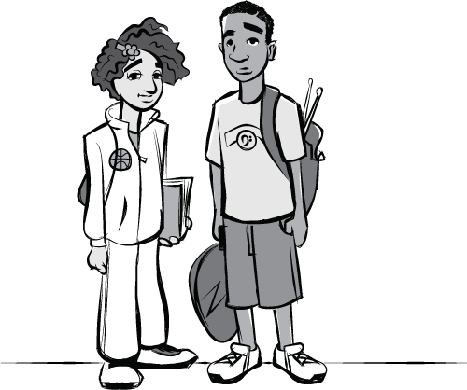
Changes During Adolescence
Physical Changes
  Menstrual periods
  Breast and genital development
  Growth of pubic hair
  Sexual arousal
Emotional Changes
  Feel like their experiences are unique and no one understands them
Notes:
Changes During Adolescence
Physical Changes
Menstrual periods
Breast and genital development
Growth of pubic hair
Erections and sexual arousal (e.g., wet dreams)
***Note that you may need to address any cultural norms associated with conversation about these topics, such as these being taboo topics or very uncomfortable topics to talk about.
Emotional Changes
Feel like their experiences are unique and no one understands them – this is becaue of their level of cognitive/brain development

Slide 9
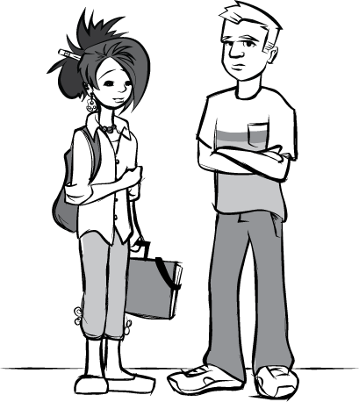
Changes During Adolescence
Changes in Social Relationships
  Begin to rely more on friends
  Influenced by friends and peers
  Want to spend more time with friends
  Interested in others in a romantic way
Notes:
Changes During Adolescence
Changes in Social Relationships
Begin to rely more on friends
Influenced by friends and peers
Want to spend more time with friends
Interested in individuals in a romantic way

Slide 10
Effective and Positive Parenting
Positive attention to good behavior
  Notice and appreciate good behavior
  Use encouraging words and phrases (e.g., “You can do it!”)
Notes:
Effective and Positive Parenting
Positive attention to good behavior
Children need to feel like their behaviors are being noticed and appreciated by their parents -- this increases the likelihood that good behaviors will occur again, and it helps boost your child’s self-esteem.
When your child is trying to accomplish something that is important to them that might be difficult, use encouraging phrases like:
“You can do it!”
“You’re doing a really great job so far!”

Slide 11
Effective and Positive Parenting
Mutual respect
  Let children know that they matter
    Focus on who children are and what they can do, rather than who they are not and what they cannot do
One-on-one time
  Take an interest in something your child likes to do
Notes:
Effective and Positive Parenting
2. Mutual respect
Respect is a two-way street. This does not mean that parent and child are equals but the child understands that their thoughts and feelings will be considered by the parent.
Let children know that they matter.
Focus on who children are and what they can do, rather than who they are not and what they cannot do.
3. One-on-one time
Take an interest in something your child likes to do.
This will help you supervise your child, while also strengthening your relationship.

Slide 12
Effective and Positive Parenting
Open communication
  Show an interest in what your child has to say
  Parent and child have an opportunity to speak and be heard
Notes:
Effective and Positive Parenting
Open communication
Open communication allows both the parent and child an opportunity to speak and be heard.
This shows the child that the parent is interested in what he/she has to say.
Show an interest in what the child has to say.

Slide 13
Effective and Positive Parenting
Appropriate supervision and rules
  Children, even teenagers, need to be supervised– they need rules and parents should enforce the rules
  Always know where your children are going, what they are doing, who they are with, and when they will be home
Notes:
Effective and Positive Parenting
Appropriate supervision and rules
Children, even teenagers, need to be supervised—they need rules and parents should enforce the rules.
Always know where they are going, what they are doing, who they are with, and when they’ll be home.
If the child is at a friend’s house, at a party some place else, or even at your own home, a responsible adult should be supervising them.

Slide 14
Effective and Positive Parenting
6. Accept your child
  Children will develop their own beliefs, and you ​may have differing beliefs, that is okay​
  Continue to show your child your acceptance and support​
Notes:
6. Accept your child.
Even if you don’t see eye-to-eye with your child on everything, it’s important to show them acceptance and support.
Children will develop their own beliefs, and their ​caregivers and immediate family members ​may have differing beliefs ​too​.
Remember that these conversations are not necessarily going to end with your child agreeing with everything you think, and that is ​okay​.
Continue to show your child your love and support. ​​

Slide 15
Tips for Successful Communication
Be aware of your body language
  Make eye contact
  Keep your verbal and nonverbal messages consistent
  Example:
  You are facing your child’s direction and making eye contact while they are talking.
Notes:
Tips for Successful Communication
Be aware of your body language.
Make eye contact.
Keep your verbal and nonverbal messages consistent.
Example:
You are facing your child’s direction and making eye contact while they are talking.
This conveys that you are interested in what your child is saying.
Example:
You cross your arms, tap your foot, and glare at your child.
The body language here is conveying that the parent is possibly upset and angry with their child. However, the message the parent is trying to get across is unclear and confusing.

Slide 16
Tips for Successful Communication
Actively listen
  Be open to listen to other views
  Summarize what your child is saying
  Take turns talking
  Example:
  “It sounds like you are very disappointed and upset that you have to stay home this weekend.”
Notes:
Tips for Successful Communication
Actively listen.
Be open to listen to other views.
Summarize what your child is saying – we can’t show we understand or are trying to understand if we don’t try to summarize/reflect what the child is saying.
Take turns talking – we can’t listen if we are doing all of the talking
Example:
“You sound very disappointed and upset. I’m willing to listen if you want to talk about it.”

Slide 17
Tips for Successful Communication
Ask open-ended questions
  Start with “What”, “Why”, and “How”
  Cannot be answered with a “Yes” or “No”
  Examples:
  “How was your day?”
  “What are you plans for this weekend?”
  “Why do you look upset?”
  “Tell me more about that."
Notes:
Tips for Successful Communication
Ask open-ended questions.
Start with “What”, “Why”, and “How”.
Cannot be answered with a “yes” or “no” like closed questions.
Examples of closed questions:
Can we talk about it?
Did you have fun?
Did you have a nice day?
Examples:
“How was your day?”
“What are your plans for this weekend?”
“Why do you look upset?”
“Tell me more about that.”

Slide 18
Tips for Successful Communication
Use “I” messages to describe how you feel
  Example 1:
    “You are never home on time.”
    “I really worry when you are not home on time.”
  Example 2:
    “You are rude– that was not a nice thing to say to me.”
    “I’m hurt when we are not getting along.”
Notes:
Tips for Successful Communication
Use “I” messages to describe how you feel.
“I” messages are a way to say how you feel without attacking or blaming; opposite of “you” messages
Example 1:
“You scare me when you don’t come home on time.” [you statement]
“I really worry when you are not home.” [“I” statement]
Example 2:
“You are hurting my feelings.” [you statement]
“I’m hurt when we aren’t getting along.” [“I” statement]

Slide 19
Ground Rules
Suggested Ground Rules:
  Respect each other’s privacy.
  We have the right to our point of view.
  Everyone deserves to be heard.
  We will strive to be supportive and encouraging of others.
  There is no such thing as a stupid question or one “right” answer.
  Attendance is important and expected at all sessions.
  No cell phones and try to limit interruptions.
  Mute yourself when not talking.
Notes:
Suggested Ground Rules
Respect each other’s privacy.
We have the right to our point of view.
Be respectful of everyone's sexual orientation and sexual identity.
Everyone deserves to be heard.
We will strive to be supportive and encouraging of others.
There is no such thing as a stupid question or one “right” answer
Attendance is important and expected at all sessions.
No cell phones and try to limit interruptions.
Mute yourself when not talking.

Slide 20
Parking Lot

Slide 21
Icebreaker 1
Introduce yourself and tell us:
  How many children do you have?
  Share something positive about your child.
  Why did you choose to participant in HeaRT for Parents?
We’ll go in this order:
  [List Participant Names]
  [Facilitator Last]

Slide 22

Activity: Parenting Pie
Identify the ingredients you think are essential in the recipe for a good parent-child relationship.

Slide 23

Communication Blockers
You will not get any more information from your child about what happened with the car, especially if it was their fault because you are blaming and criticizing.
Alternative Building Block:
What happened to the car?
Look at what you did
The car is ruined!
It’s all your fault!

Slide 24

Communication Blockers
The parent has left the door open for the child to talk more, but they are not forcing conversation.
You sound very frustrated and disappointed. I am wiling to listen if you want to talk about it.

Slide 25

Communication Blockers
This is an example of criticizing. Avoid saying “you ought to” or “you should.”
Alternative Building Block:
This is very important and means a lot to me.
I should not have to tell you—you ought to see how important that is!

Slide 26
Communication Blockers
This nonverbal communication here is being done in a critical manner and the message the parent is trying to get across is unclear and confusing.
Alternative Building Block:
When talking or listening to your child, it is best to maintain an open posture (e.g., open arms, body facing child, eye contact).
If you are upset about something, verbally express that by saying, “I am very upset right now.”
You cross your arms, tap your foot, and stand in front of your child, glaring at them.

Slide 27
Communication Blockers
Using open-ended statements or questions will elicit more information from the child.
It sounds like you had a rough day! Tell me more about it.

Slide 28
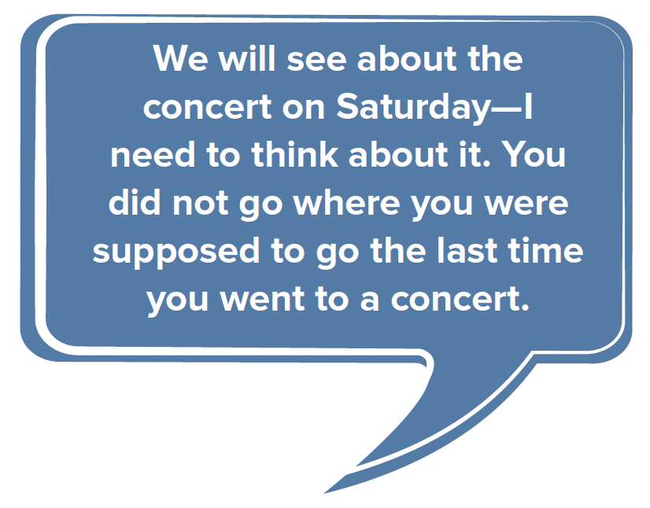
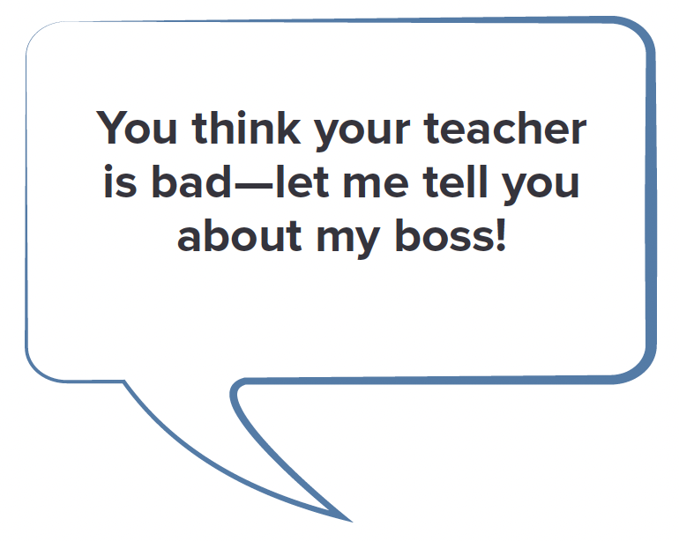
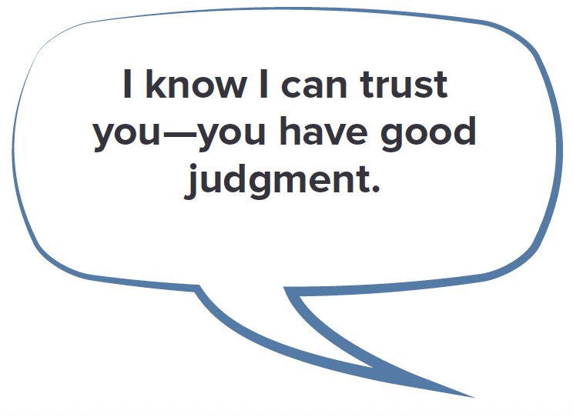
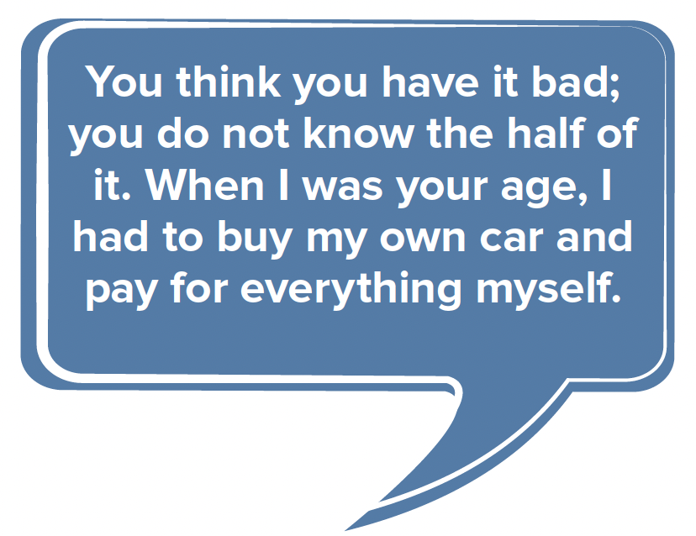
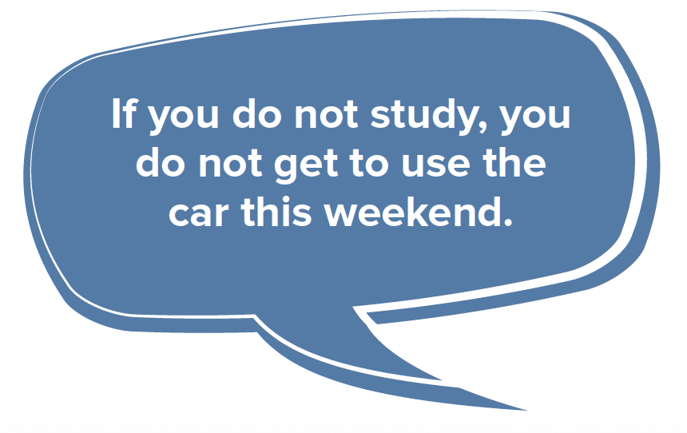
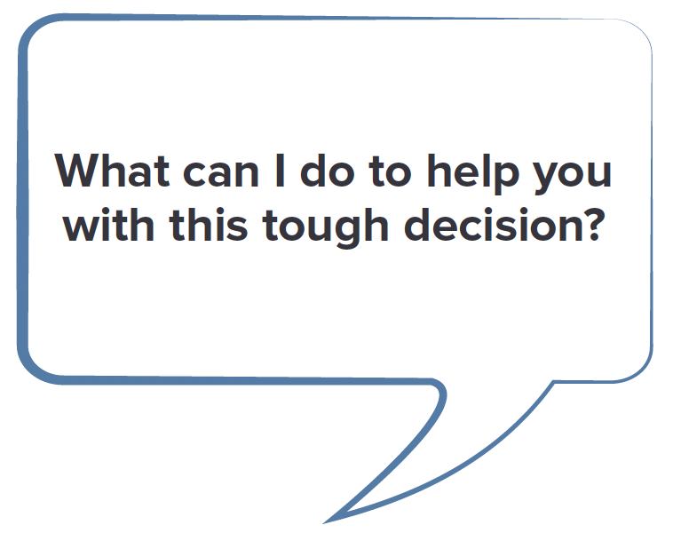
Communication Blockers

Slide 29
Session 3:
Parenting By Example

Slide 30
Characteristics of Healthy Relationships
Both partners feel equal power
Trust
Open and honest communication
Respectful interaction styles
Space to pursue individual interests
Appropriate boundaries
Notes:
Point out that most healthy relationships, including parent-child relationships, consist of these characteristics but healthy dating relationships also require an equal distribution of power. One partner should not consistently tell the other partner what to do, wear, say, etc. Of course, parent-child relationships are not characterized by an equal distribution of power.

Slide 31
Characteristics of Unhealthy Relationships
One or both partners feels disempowered
Absence of trust
Poor communication
Partners are disrespectful to one another
Not enough space is allowed to pursue individual interests
Boundaries may be overstepped/disregarded
Notes:
Emphasize that unhealthy relationships are lacking one or more of the characteristics of healthy relationships.
Point out that unhealthy relationships can become unsafe and abusive but unhealthy does not necessarily imply that the relationship is unsafe or abusive.

Slide 32
What is Teen Dating Violence?
Specific type of unhealthy relationship
Includes actual or threatened harm
Can be:
  Physical
  Sexual
  Emotional (psychological/verbal)
  Stalking
Notes:
Teen dating violence is a type of intimate partner violence that has the potential to result in injury, death, or psychological harm. It is defined as the physical, sexual, and/or emotional violence within a dating relationship, as well as stalking.
In relationships where dating violence is occurring, there is typically one person in the relationship who is the primary aggressor; there is often a pattern; there is coercion where attempts are made to erode a person’s ability to say yes or no; behaviors are used to gain and maintain power and control – this can include financial coercion.
Physical dating violence refers to instances when a partner is pinched, hit, shoved, or kicked. These are acts that involve some inappropriate physical interactions between the dating partners.
Sexual dating violence involves the use of force or pressure to engage a partner in a sex act when he or she does not or cannot consent.
Emotional (psychological or verbal) violence refers to instances where a partner’s sense of self-worth is threatened or harmed. Examples include name calling, shaming, bullying, embarrassing on purpose, or keeping him/her away from friends and family.
Stalking refers to a pattern of harassing or threatening acts used by a perpetrator that is both unwanted and causes fear in the victim.

Slide 33
Teen Dating Violence
Occurs in “dating” relationships
  Current or former partner, boyfriend, girlfriend, or someone wanting a romantic relationship
Can occur among heterosexual or same-sex couples
Can occur in person or electronically
Notes:
Dating violence occurs in “dating” relationships.
This includes two people in a former or current close relationship or someone wanting a romantic relationship.
Dating violence can occur among heterosexual (male/female) or same-sex couples and can occur in person or electronically, such as through text messaging or social media.

Slide 34
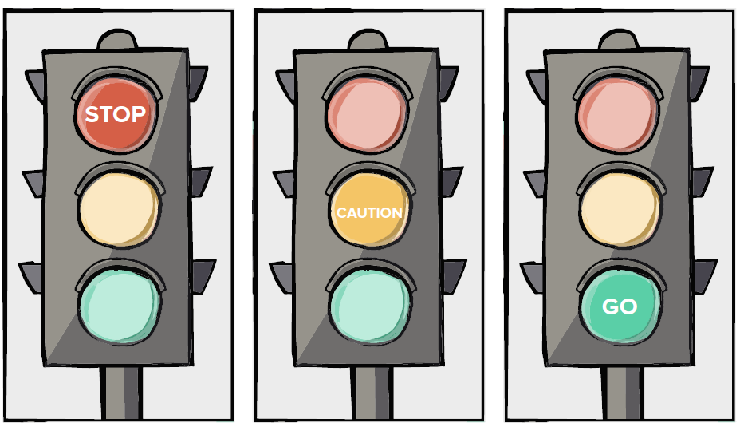
Are these red, yellow, or green light behaviors?

Slide 35
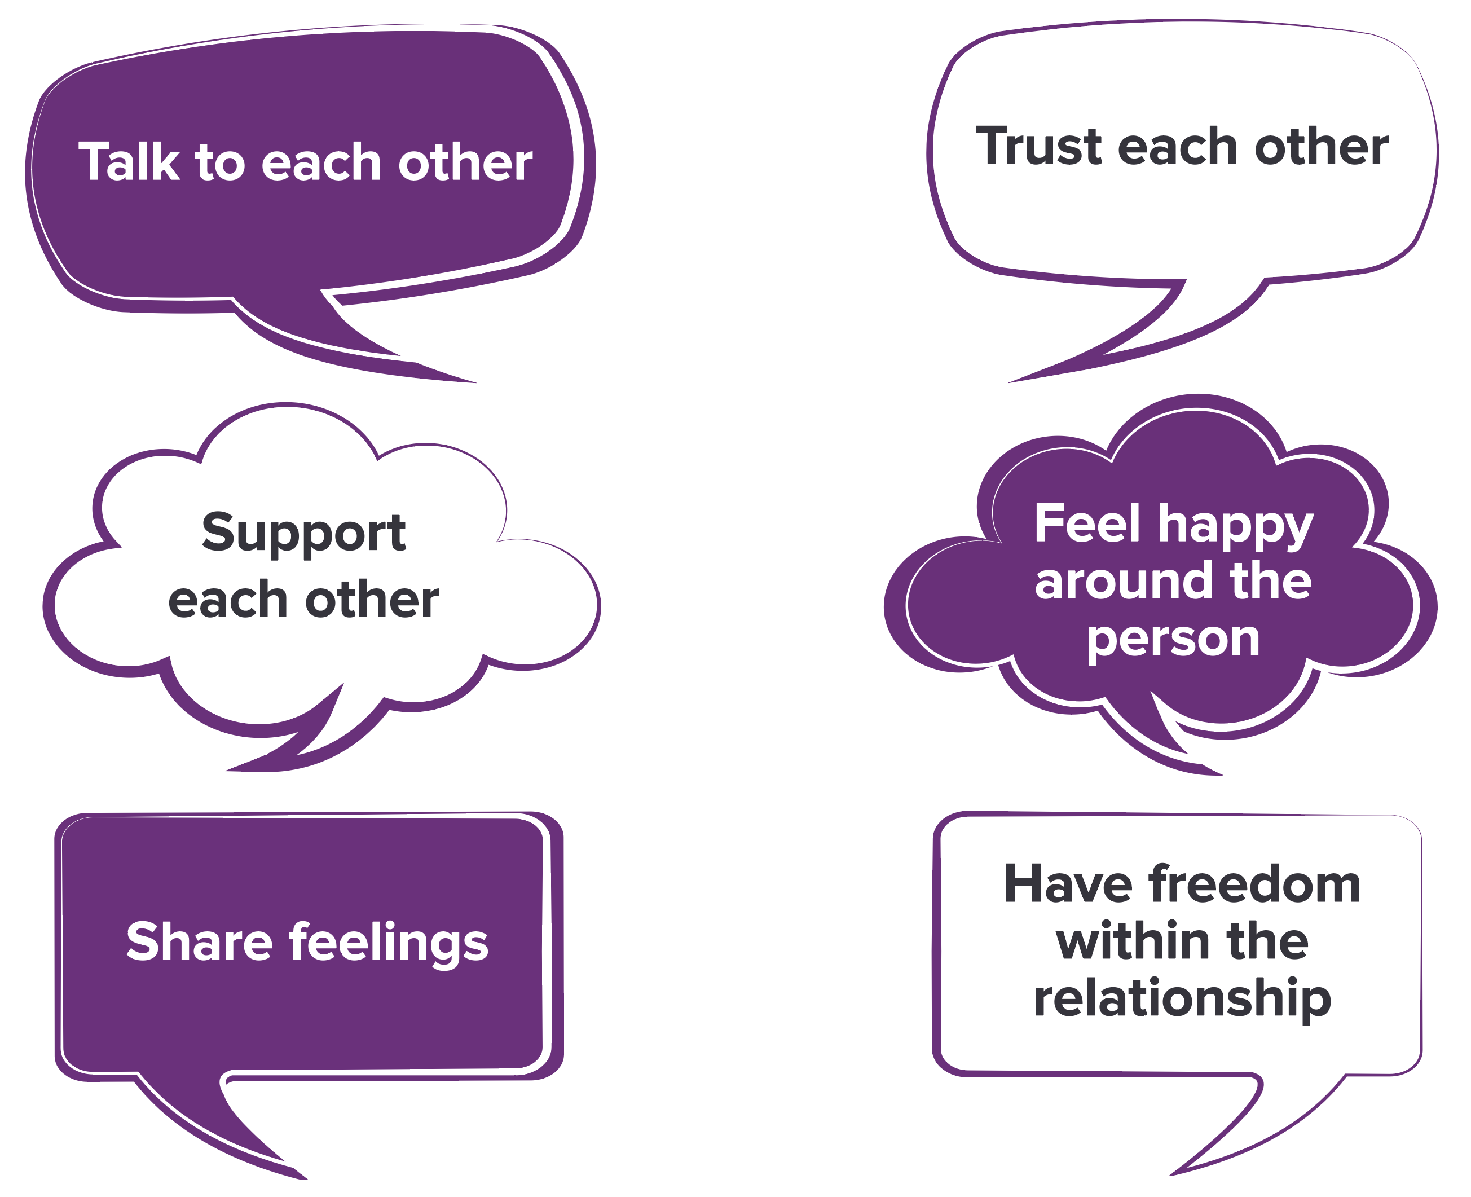
S3 Supplementary Slides – Traffic lights

Slide 36
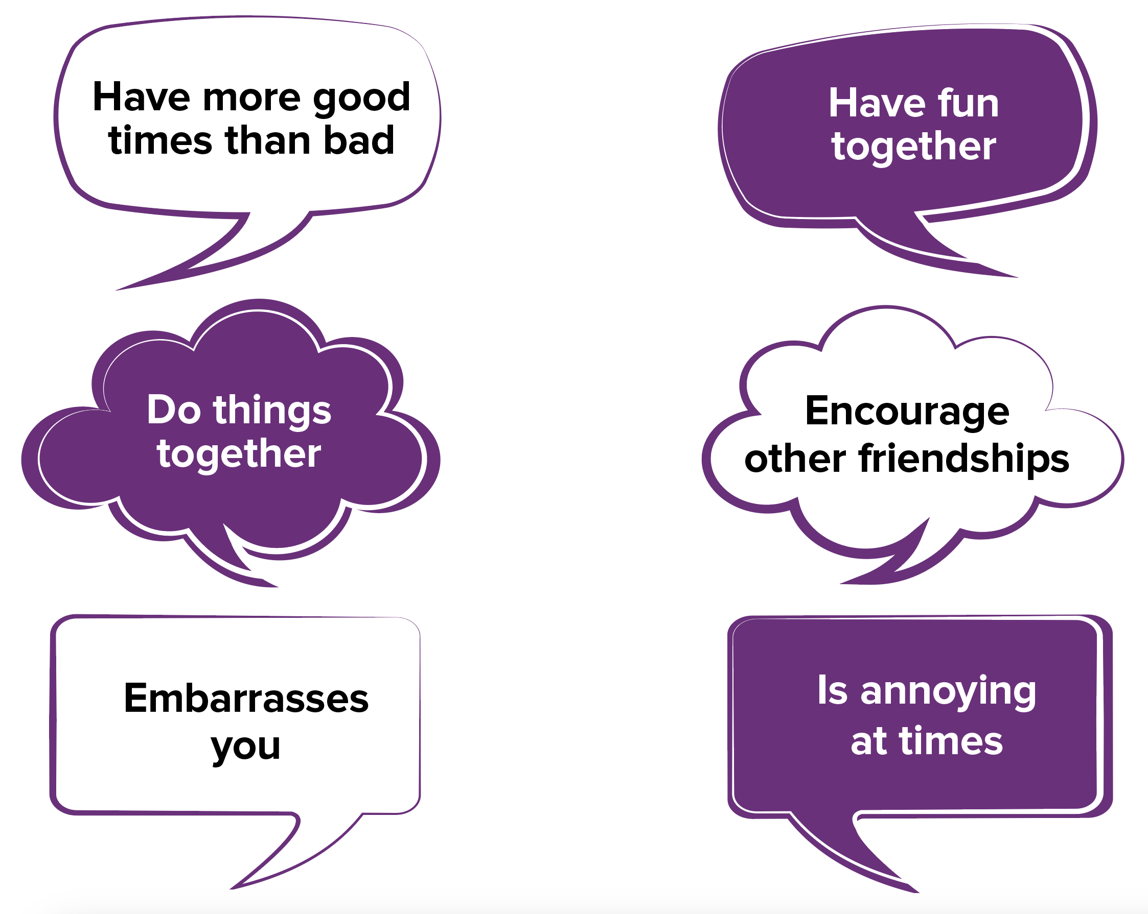
S3 Supplementary Slides – Traffic lights continued

Slide 37
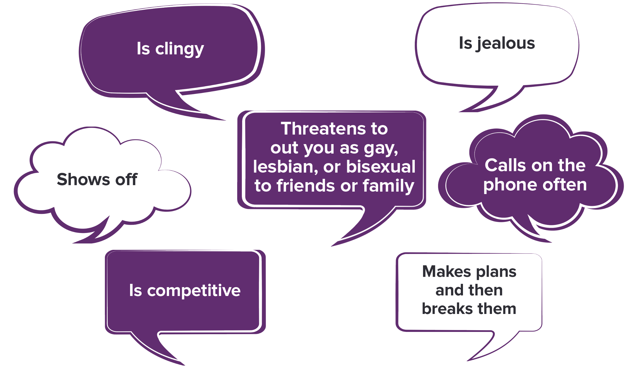
S3 Supplementary Slides - negative attributes

Slide 38
How Does This Apply to Me?
True or False?
Teen dating violence happens in same-sex relationships as often as it happens in straight relationships.
TRUE. Anyone can experience abuse and violence in their relationships and lesbian, gay, and bisexual people are no different.

Slide 39
How Does This Apply to Me?
True or False?
Boys are as likely as girls to be the victims of physical dating violence.
FALSE. In a 2017 survey, almost 1 in 11 (9.1%) high school girls compared to 1 in 15 (6.5%) high school boys reported experiencing physical dating violence from a partner in the past 12 months.
Notes:
NOTE: The data shown here is from the 2017 Youth Risk Behavior Survey, a national survey of high school students in the US. Data from the 2019 survey found very similar results-- that 9.3% of girls and 7% of boys experienced physical dating violence in the last 12 months.

Slide 40
How Does This Apply to Me?
True or False?
Girls are more likely than boys to be the victims of serious physical and sexual violence.
TRUE. Girls are more likely than boys to be the victims of serious physical and sexual violence.

Slide 41
How Does This Apply to Me?
True or False?
Dating violence does not start until high school or college.
FALSE. Among adults who experience rape, physical violence, and/or stalking by an intimate partner about 1 in 4 (27%) of women and in 5 men (21%) first experience some form of partner violence between 11 and 17 years of age.

Slide 42

Relationship Scenarios
1. Anthony and Carla have been married for 15 years and have two children. Within the last year, they have begun to bump heads on a number of different issues. They do not argue or raise their voices at each other in front of their children. Instead, they wait until the children go to bed, and they quietly address their conflicts. One day while Carla is preparing breakfast for the children, Anthony comes into the kitchen and says he is late for work and may miss a meeting. After Anthony goes out the door, Carla says under her breath, “If your boss ever realizes what a loser you are, he will fire you”.

Slide 43

Relationship Scenarios
2. Troy and Carrie have three small children. Over the course of their marriage, Troy has been increasingly concerned with knowing where Carrie is, who she is with, and what she is doing. Troy calls Carrie at least twice an hour and if he cannot reach her, he calls her friends or family to locate her. As a result, Carrie has few friends and does not go out of the house often.

Slide 44

Relationship Scenarios
3. Monique has been divorced for several years and recently started dating a man from the neighborhood named Sam. She has two children who live with her. One day while they are watching TV with the children, Monique receives a call from one of her friends from childhood, Jason. When she finishes her phone call, Sam demands to know who she was talking to and says that she must be cheating on him with Jason. When Monique explains that Jason is just her friend, Sam shoves her into the wall and leaves.

Slide 45

Relationship Scenarios
4. Jabar and Alex have been ​together​ for 23 years and have five children ranging in age from 8 to 18. Jabar and Alex both car​e​ for their children and alternate responsib​i​l​ity​ for various aspects of the household (or which children to assign such tasks to), such as taking the children to after​-​school activities, doing laundry and dishes, taking out the garbage, etc.

Slide 46

Relationship Scenarios
5. Chris and Taylor are divorced and they have a pre-teen daughter, Shyla. Shyla often skips school, runs away, and has been caught shoplifting. Chris and Taylor often disagree about how to parent Shyla and have frequent arguments about this. Taylor regularly tells Shyla that if it were not for her, she and Chris would probably still be married.

Slide 47

Relationship Scenarios.
6. Jack and Michele share custody of their children and alternate weeks in which they care for the children. One day when Jack drops off the children at Michele’s apartment, he notices that there is a man sitting in the living room. Michelle introduces this man as her new boyfriend. Jack asks to talk to Michelle outside and says that he is concerned about having someone he does not know spend time around the children. Michelle calls her boyfriend outside and tells him that Jack thinks he should not be trusted around her kids and that maybe he will mistreat them.
The two men scuffle and Jack leaves.

Slide 48
Relationship Scenarios
7. Tami and Jordan have three children. They make it a point not to fight in front of their children, but they often do not say anything to each other for days. The older child also often hears their parents arguing in their bedroom and notices that Tami and Jordan call each other bad names during their arguments.

Slide 49
Relationship Scenarios
8. Eva is a single mother of three teenage daughters. Over the last several years, Eva has had several partners who have lived in her home. Eva’s daughters have seen these men hit their mother, and Eva always has an excuse for their behavior. In one instance, Eva said she provoked the man because she accused him of talking to another woman. In another instance, she said that the man was stressed because of his job and just was not himself. The girls heard the man tell their mother, “I love you so much; you just make me so angry sometimes.” In yet another situation, Eva said that it was an accident and that the man did not really mean to hit her.

Slide 50
Relationship Scenarios
9. Jayda and Hines have lived together for six years and have a 6-year-old son and a 2-year-old daughter. Jayda comes home from work one day and yells at Hines telling him that the concert he was supposed to get tickets for is now sold out. Hines is angry and yells back at Jayda. The children witness the argument. Later in the evening Hines apologizes to Jayda for forgetting and Jayda apologizes to Hines for getting angry.

Slide 51
Relationship Scenarios
10. Demetrius is a single father of three young children. The mother of his children has a substance use problem and rarely sees the children. Demetrius has a serious girlfriend but she does not like his children and the two have frequent arguments about what Demetrius should do regarding the behavior of his children. It is not uncommon for Demetrius’ girlfriend to hit him and tell him that he is a horrible father and that he will never get another woman because of his three children.

Slide 52
Video: Children See, Children Do
https://www.youtube.com/watch?v=XbUBy2Nt5f4

Slide 53
Session 5:
Parenting Skillfully

Slide 54
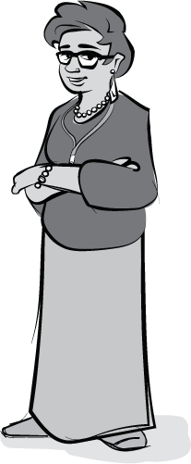
What is Parental Supervision?
Expectations parents have for their child’s behavior
Actions parents take to keep track of their child
Ways parents respond when their child breaks the rules
Notes:
During the teen years, a lot of changes are happening for our children – it is a period of rapid growth, exploration, and risk taking. The exploration and risk taking provide opportunities for our children to test their skills and abilities and discover who they are. However, we need to make sure that we are providing the guidance they need to ensure their health and well-being. We provide this guidance by supervising their activities.
What is Parental Supervision?
Parental supervision includes:
Expectations parents have for their child’s behavior
Actions parents take to keep track of their child
Ways parents respond when their child breaks the rules

Slide 55
Why is Parental Supervision Important?
Children whose parents use effective supervision practices make better decisions and avoid:
Having sex at an early age
Smoking cigarettes
Drinking alcohol
Being physically aggressive
Skipping school
Engaging in teen dating violence
Notes:
Why is Parental Supervision Important?
Parental supervision is associated with decreases in a number of risky adolescent behaviors. Lack of supervision, along with several other parenting behaviors (such as inconsistent and harsh discipline), is associated with an increased risk for teen dating violence.
Children whose parents use effective supervision practices make better decisions and avoid^{1, 2, 3, 4, 5, 6}:
Having sex at an early age
Smoking cigarettes
Drinking alcohol
Being physically aggressive
Skipping school
Engaging in teen dating violence
¹ Brendgen, M., Vitaro, R., Tremblay, R.E., et al. (2001). Reactive and proactive aggression: predictions to physical violence in different contexts and moderating effects of parental monitoring and caregiving behavior. Journal of Abnormal Child Psychology, 29(4), 293–304.
² Choquet, M., Hassler, C., Morin, D., et al. (2008). Perceived parenting styles and tobacco, alcohol and cannabis use among French adolescents: gender and family structure differentials. Alcohol & Alcoholism, 43(1),73–80.
³ Cota-Robles, S, & Gamble, W. (2006). Parent-adolescent processes and reduced risk for delinquency: the effect of gender for Mexican American adolescents. Youth & Society, 37(4), 375–392.
⁴ Foshee, V.A., & Matthew, R.A. (2007). Adolescent dating abuse perpetration: A review of findings, methodological limitations, and suggestions for future research. In DJ Flannery, AT Vazjoni, & ID Waldman (Eds.), The Cambridge Handbook of Violence Behavior and Aggression (pp. 431-449). New York: Cambridge.
⁵ Li, X., Feigelman, S., & Stanton, B. (2000). Perceived parental monitoring and health risk behaviors among urban low-income African-American children and adolescents. Journal of Adolescent Health, 27(1), 43–48.
⁶ Markham, C.M, Lormand, D., Gloppen, K.M., et al. (2010). Connectedness as a predictor of sexual and reproductive health outcomes for youth. Journal of Adolescent Health, 46(3 Suppl 1), S23–S41.

Slide 56

How Can I Supervise My Child?
Parental supervision is being used when parents ask their child:
Where will you be?
Who will you be with?
What will you be doing?
When will you be home?
Notes:
What is Parental Supervision?
Parental supervision is being used when parents ask their child:
Where will you be?
Who will you be with?
When will you be home?
What will you be doing?
Note: When asking “Who will you be with?”, parents should make sure that a responsible adult will be present, not just children.

Slide 57
How Can I Supervise My Child?
Parents are also supervising when they:
Check in with their child by phone
Get to know their child’s friends and their parents
Talk with their child about how he or she spends time or whether he or she is making safe choices
Set and enforce rules for their child’s behavior
Notes:
What is Parental Supervision?
Parents are also supervising when they:
Check in with their child by phone.
Get to know their child’s friends and their parents.
Talk with their child about how he/she spends time or whether he/she is making safe choices.
Set and enforce rules for their child’s behavior.
Note: A more in-depth list of ways to supervise your children is included in your Parent Handbook.

Slide 58
Teen Risk Behaviors: The Facts
Over 1 in 5 high school students report drinking alcohol in the last 30 days
Almost 1 out of 5 students have tried cigarette smoking
3 in 10 students report having sex
Nearly 2 in 5 high school students have tried electronic vapor (“vape”) products
Over 1 in 5 high school students report drinking alcohol or taking drugs the last time they had sex
Almost half of sexually active high school students report not using a condom the last time they had sex

Slide 59
Conflict Resolution
Step 1: Define the issue or problem
Parent and child express their views about the problem
Use good communication skills
  Use “I” messages
  Ask open-ended questions
  Summarize what is said
Notes:
Prior to engaging in Step 1, it is important that parents understand what they are/are not willing to negotiate. If the conflict is over something that is non-negotiable, the parent should let the child know this and avoid any further discussions about the topic. When parents engage the child in discussion, it feels as if the parent might be willing to hear the child’s point of view and change their mind or offer a different solution.
*Note: This 4-step plan for conflict resolution was adapted from:
Robin, A. L., & Foster, S. L. (1989). Negotiating Parent-Adolescent Conflict. New York, NY: The Guilford
Press.
Conflict Resolution
Step 1: Define the issue or problem.
Parent and child express their views about the problem.
Listen and try to understand each other’s point of view.
Use good communication skills.
Use “I” messages.
Ask open-ended questions.
Summarize what is said.

Slide 60
Conflict Resolution
Step 2: Discuss possible solutions
Parent and child suggest solutions to resolve the conflict
Parent and child listen to each other’s solutions without interrupting or becoming defensive
Notes:
Conflict Resolution
Step 2: Discuss possible solutions.
Parent and child suggest solutions to resolve the conflict.
Parent and child listen to each other’s solutions without interrupting or becoming defensive.
Note: Keep in mind that listening to and trying to understand the child’s point of view are not the same as agreeing.
During this stage of the conflict, we can state some shared long-term goals and try to refocus the conflict so parent and child are both focused on solutions to the same thing, which is this shared long-term goal. For example, if we are having a conflict about the child feeling controlled, it would be good to say that we both want the child to become a healthy, independent adult and that the conflict is only about how to get there.
If a child is not doing his/her chores and it is creating conflict, parents may say: “We are all part of this household, we work together. The question is how to best work together and what would be a fair and reasonable way to get things done.”

Slide 61
Conflict Resolution
Step 3: Choose and implement a solution
Evaluate both parent and child suggestions
Choose one option on which parent and child can agree and implement the solution
Notes:
Conflict Resolution
Step 3: Choose and implement a solution.
Evaluate both parent and child suggestions.
Choose one option on which parent and child can agree and implement the solution.
Note: Before evaluating the solutions in this step, we should think about what things we’re willing to negotiate on and what is just not negotiable at all. Although it may be difficult, it’s important for us to keep an open mind when looking at the potential solutions because that could make the difference between positive and negative outcomes.

Slide 62
Conflict Resolution
Step 4: Evaluate the effectiveness of the solution
Parent and child should evaluate the problem and solution after some time has passed
Notes:
Conflict Resolution
Step 4: Evaluate the effectiveness of the solution.
Parent and child should evaluate the problem and solution after some time has passed.
After some time has passed, both the parent and child should evaluate how well the solution has worked. If the problem still exists, the process should be started over beginning with Step 1.

Slide 63
Question of the Day
We’ll go around the room and each person can:
State your name
Tell us one fun thing you did since the last session

Slide 64
In-home Session 4 Review
During your home session, you practiced your positive parenting and communication skills. How did it go? How did you feel during the interactions? Any concerns/problems?
You also spent time discussing a difficult or sensitive topic with your child. How did it go? How did you feel during the interactions? Any concerns/problems?
You also looked at your child’s relationship behaviors to get an idea of your child’s relationship health. How did it go? Did anyone not know the answers at first? Did anyone talk to their child to find out the answer? Anyone surprised or proud of the influence you have had on your child?

Slide 65

Supervising electronic media usage
What are some of the advantages to children having access to technology?
[response]
[response]
[response]
[response]
[response]
[response]
Notes:
Write participant responses in slide.
If not mentioned by participants, emphasize the following:
• Children can get information quickly for school or other purposes.
• Familiarity with technology is a necessity in today’s world.
• Children can stay in touch with friends and peers.
• Parents can reach children when they need to.

Slide 66
Supervising electronic media usage
What are some of the disadvantages to children having access to technology?
[response]
[response]
[response]
[response]
[response]
[response]
Notes:
Write participant responses in slide.
If not mentioned by participants, emphasize the following:
• Exposure to online predators could result in in-person meetings that place a child in grave danger (e.g., rape), or result in online exchanges of photos or other personal information (e.g., home address, school) that endanger a child.
Cyberbullying of a child on social media (e.g., Facebook), email, or through instant messaging.
• “Sexting” which involves sending or encouraging someone to send sexually explicit messages or photographs through messaging applications or in other ways; this is illegal and can get a child in a lot of trouble.

Slide 67
Other Risks in Adolescence
What are some other risks our children face as they grow up?
[response]
[response]
[response]
[response]
[response]
[response]
Notes:
Ensure that participants generate topics that involve the following areas:
Drugs and alcohol
• Curfew
• Sex
• Dating
• Gangs or violence

Slide 68
Resolving Conflict
What causes conflict or disagreement between you and your children?
[response]
[response]
[response]
[response]
[response]
[response]
Notes:
Possible answers: chores, other responsibilities, curfews, allowances, homework, visitor rules.

Slide 69
Resolving Conflict
Let us think about how we handle conflict with our children. What are some ways parents can handle conflict?
[response]
[response]
[response]
[response]
[response]
[response]
Notes:
Possible answers: yelling, demanding that the child do as the parent has requested, spanking, grounding, removing privileges, walking away, allowing the child to do as he/she wants, talking about it.

Slide 70

Conflict Resolution Role-Play
Parent: You’ve always had a rule that your child cannot be alone with a friend of the opposite sex in your house. Your child recently came out as bisexual, and you are considering changing the rule.
Child: Your best friend since 1st grade is the same sex as you. Now your parent wants to implement a new rule: you can’t be alone together to play in the house since you told them you are bisexual.

Slide 71

Conflict Resolution Role-Play
Parent: Your child asked you if they ​could​ go out on a date with another kid from their school on Saturday​,​ and you said no.
Child: Two of your best friends from school have already gone ​on dates ​to the movies. You wanted your parent to allow you to go on a date too, because you really like the person who asked you out.

Slide 72

Conflict Resolution Role-Play
Parent: Your child has been hanging out with several new friends you do not know. You have heard your child cursing when talking to them on the phone and making fun of another child from school. You want your child to be friends with whomever they want, but you are worried that the kids are a bad influence, so you have suggested that your child stay away from them.
Child: You have become friends with two 8th graders who are “popular” at school. You are really excited because you feel like other students in your grade think you are cool because you hang out with older kids but your parent says you cannot be friends with them.

